Slide 1
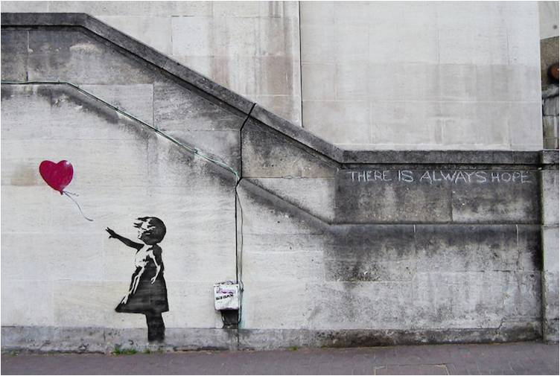
DNA-V as an integrated framework for quality of life, psychological wellbeing and physical health outcomes for children and young people with health conditions across the region of NHS Dumfries &Galloway!
Co-produced by CYP&F, staff and other random people, and presented (flex) by Dr James Lemon,
Consultant Clinical Psychologist
NHS Dumfries and Galloway
June 2019
Banksy

Slide 2
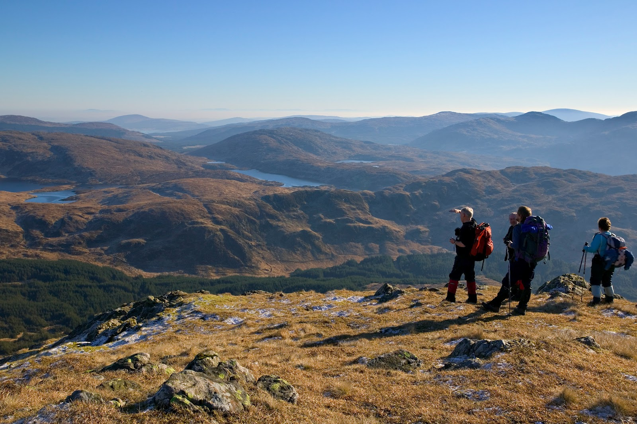
?
Notes:
We’ll join this journey in South West Scotland
This is area where are I live. It’s a largely rural area, with a population of about 150,00 people spread out over approx 2,500 square miles
60 people per square mile (wikipedia has Berlin at 10,000)
Main town is Dumfires and this is where our hospital is

Slide 3
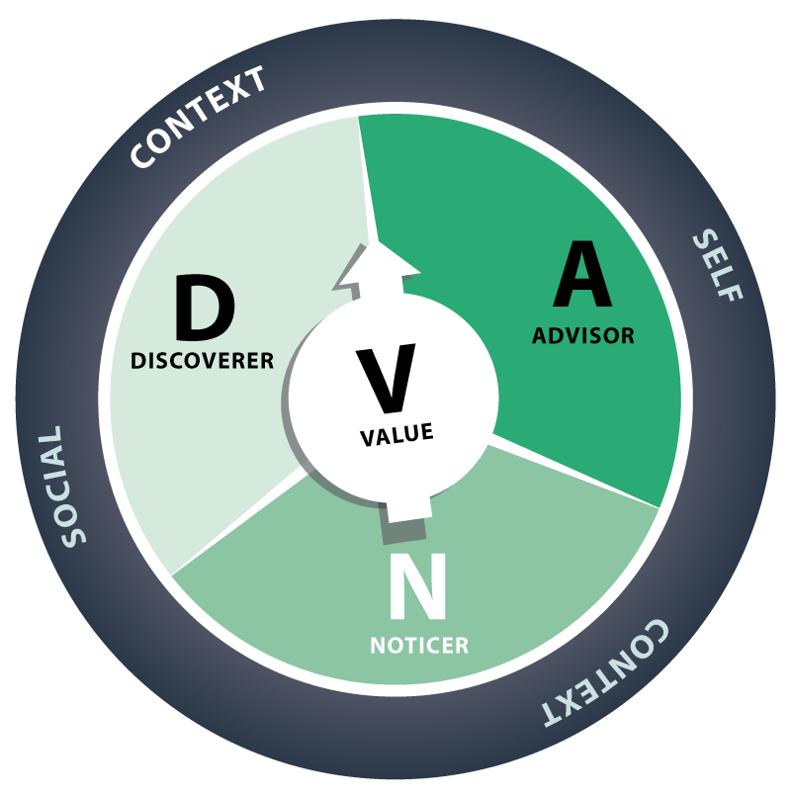

Slide 4
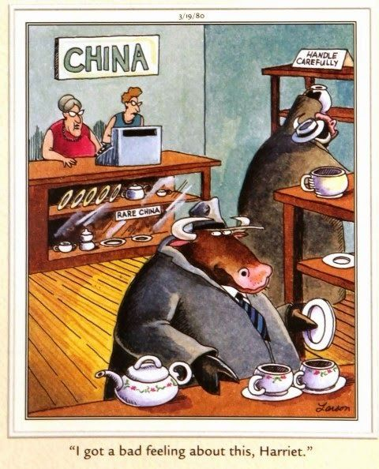

Slide 5
The Thriving Adolescent
Notes:
1:1 work adherence etc

Slide 6
Précis of the DNA-V model
DNA-V focuses on three major classes of behaviour. They serve a particular purpose. Terms are used metaphorically and pragmatically, not as concrete or biological mechanisms
Advisor: use past teaching and experience to navigate the present
Noticer: to detect physical, psychological and environmental events as they occur
Discoverer: to expand behavioural repertoires
Goal is to help young people move flexibly
between these classes of behaviour, or skills,
that help them live with vitality and within
their values

Slide 7
DNA-V: 4 Processes & 2 Perspectives
Processes:
Create contexts that empower young people to clarify what they value and choose value-consistent actions
Help people notice inner and outer experiences to appreciate their present context and choose
Help people to navigate their context with language
Help people explore in order to develop skills and resources, and expand their context

Slide 8
DNA-V: 4 Processes & 2 Perspectives
Perspectives:
Help young people take flexible perspectives on themselves
Help young people take flexible perspectives on others

Slide 9
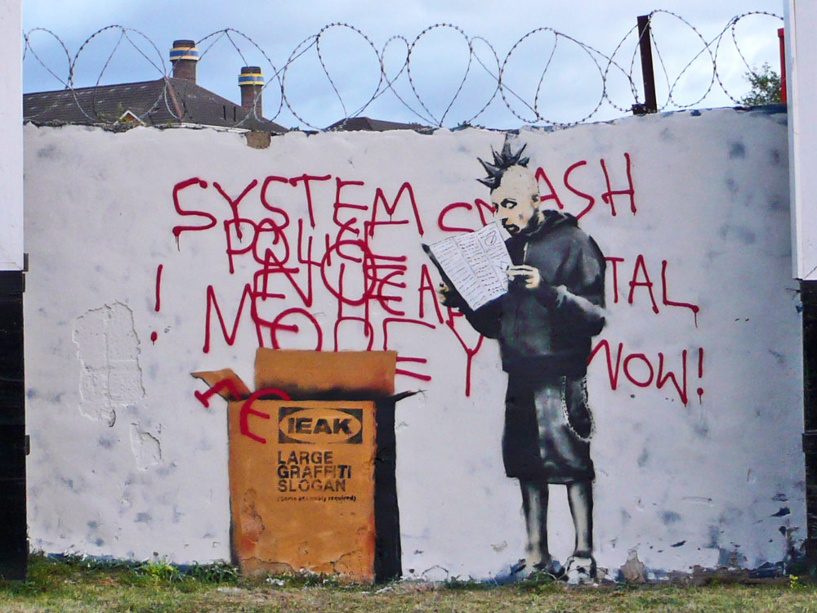

Slide 10
Notes:
4x stress etc

Slide 11
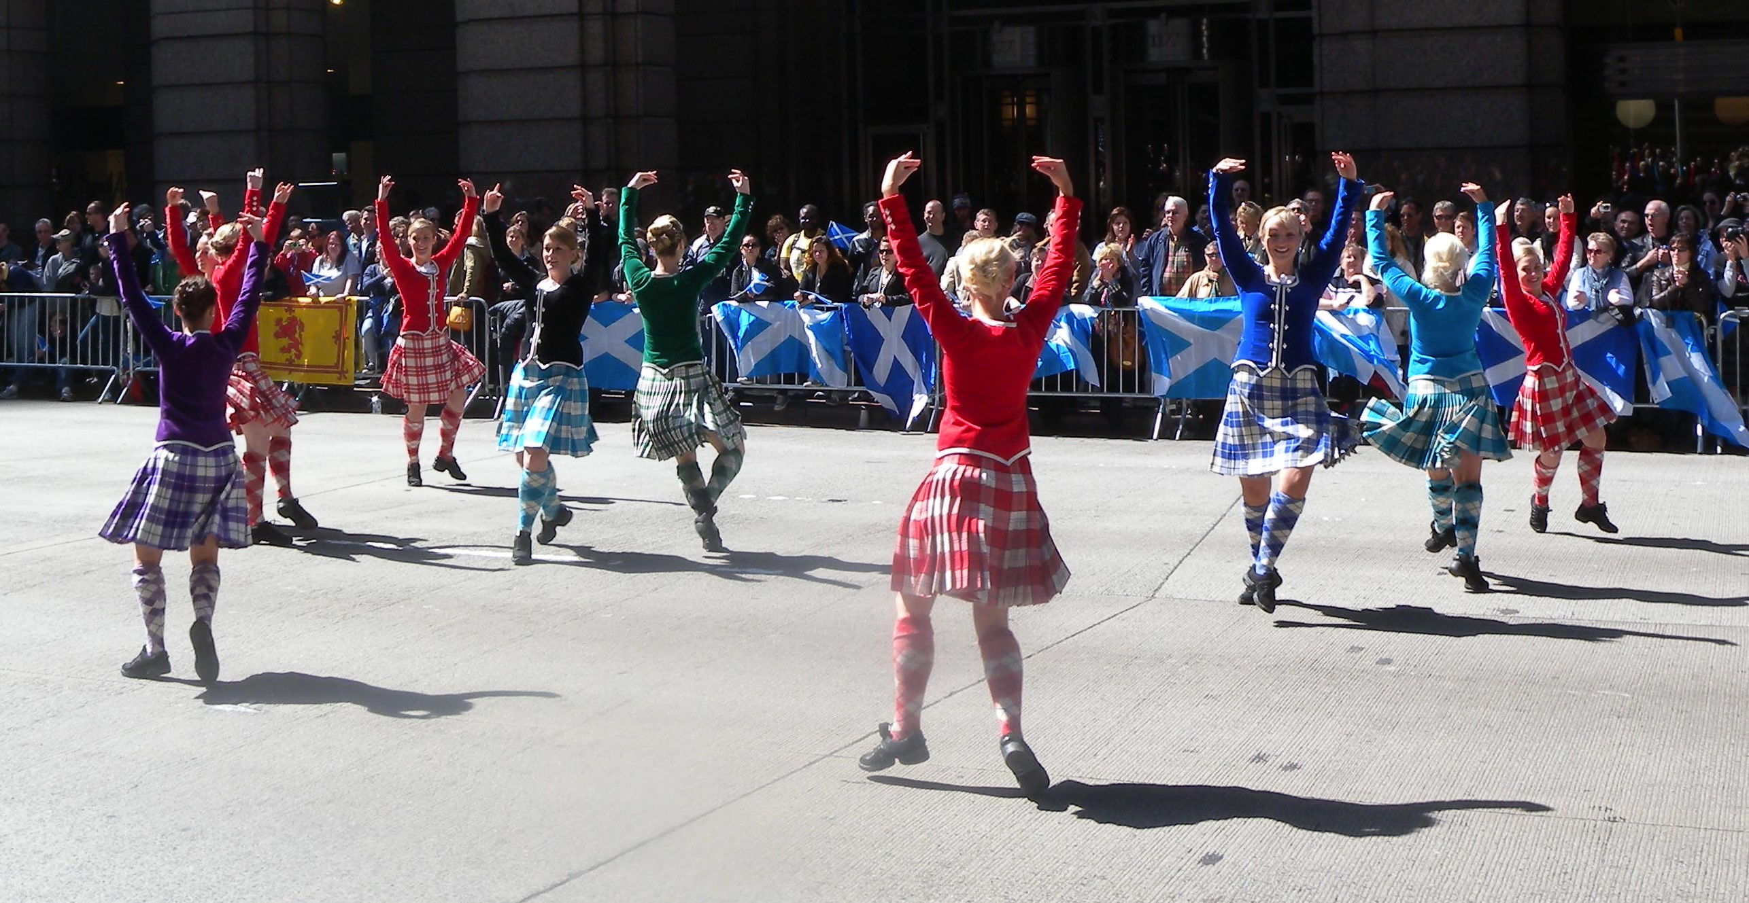
Notes:
Links with sppn

Slide 12
Cystic Fibrosis
Birth
Team working
Training the MDT
(and the paediatric physiotherapists)
Primary school introduction
Transition to Secondary school
Assessed at annual reviews
Training other staff, medical students, trainees etc

Slide 13
Introducing the DNA-V: Taking the DNA-V Walk of Life
Notes:
caleb

Slide 14
No emotional skills were taught
Fear is used
Complications without coping
Looking at the wider picture
Psychological thinking in the whole team
Its wonderful
I feel so much better and confident as a parent
Just thank-you for giving me back my child
alright

Slide 15
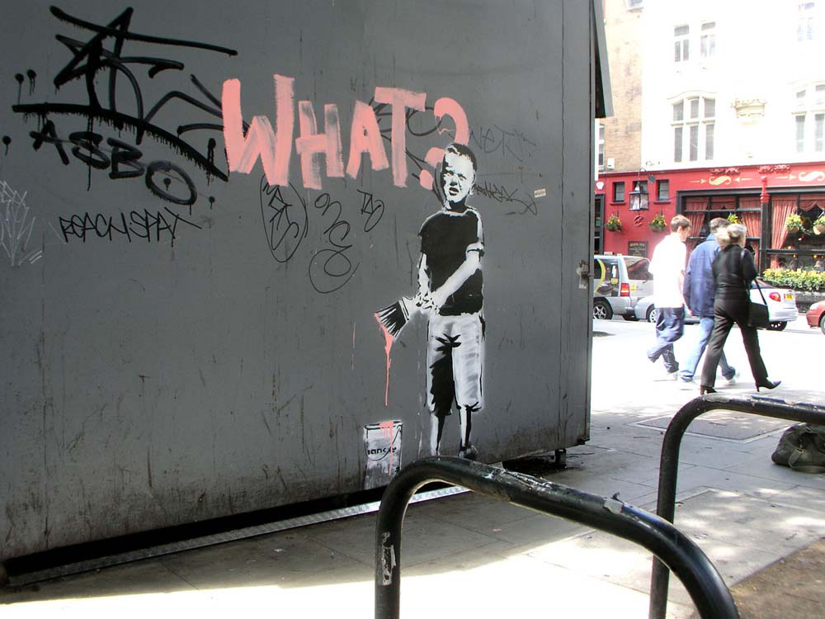
Notes:
Patients improved

Slide 16
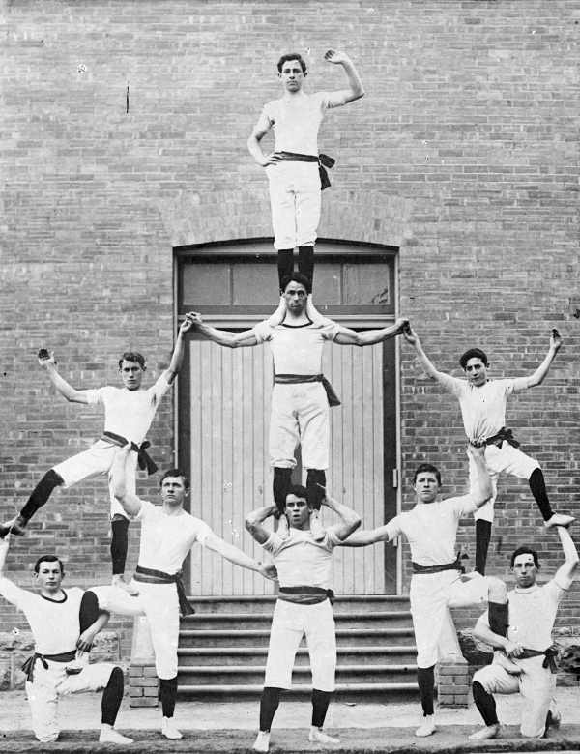
Notes:
No resources
But people

Slide 17
DNA-V assessments at 2 x yearly (!) annual reviews

Slide 19
Clinicians were interested!
Notes:
Clinicians became interested in how

Slide 20
Where to now?

